Slide 1
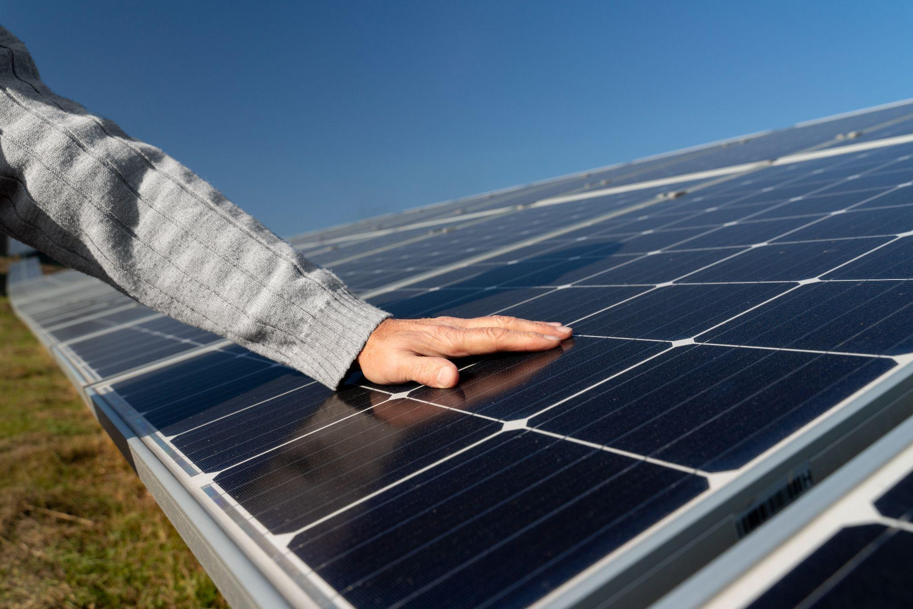
SOLAR FARM
MICROGRID PROJECT
Adhiraj Budukh, Lydia Fecker, Quinn Ferguson, Maddie Rennie, Bettina Valentiner

Slide 2
Scope
Location: 75-77 Reed Road, Hudson, MA
Goal: To establish a sustainable solar farm and microgrid that provides reliable, renewable energy for 800 homes while reducing greenhouse gas emissions.
Environmental Benefits: Decrease greenhouse gas emissions by substituting traditional power sources with solar energy, contributing to broader sustainability goals.
This project aims to create a resilient solar microgrid that supports the Hudson community's energy needs while promoting environmental sustainability and reducing overall reliance on fossil fuels.

Slide 3
Key Project Components
Solar Panel Installation
Battery Storage System
Microgrid Control System
Grid Integration
Backup Generator
Fully operational photovoltaic array designed to harness solar energy efficiently
Stores surplus solar energy to ensure uninterrupted power supply during low solar periods.
Manages energy distribution, monitors performance, and ensures optimal efficiency.
Seamless connection to Hudson Light & Power’s grid for added reliability.
A gasoline-powered system to provide additional power during emergencies.

Slide 4
Project Benefits
Environmental Impact
Community Engagement
Economic Value
Reduces dependence on fossil fuels and minimizes carbon footprint.
Aligns with Massachusetts' climate goals under the Global Warming Solutions Act.
Initiatives such as the Open Houses, the Information Sheets, and the Gridlock Summer Program will keep everyone informed and engaged with the project.
Delivers affordable electricity to the Lakeview Association residents.
Promotes financial savings through renewable energy incentives.

Slide 5
Implementation Plan
Obtain permits and regulatory approvals
Assemble and connect the microgrid system
1 - 5
7 - 12
Months
5 - 7
12 - 18
Total cost:
$2.1 - $2.2 million
Complete site preparation and material procurement
Conduct testing, community training, and final system handover

Slide 6
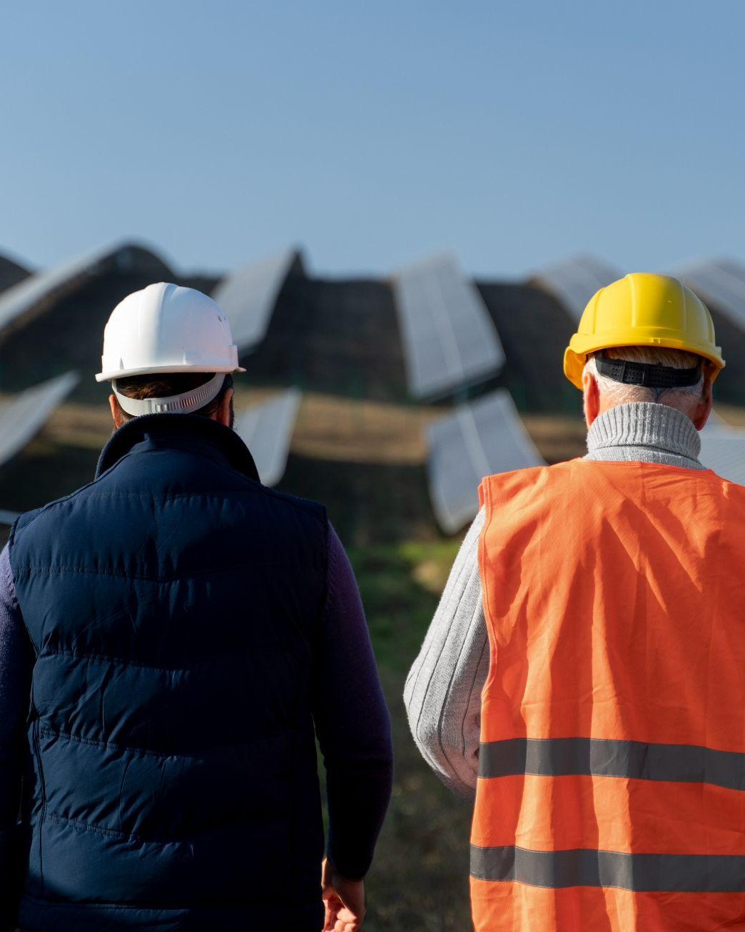
Key Stakeholders
Project Team
Community Members
Hudson Light & Power
Investors

Slide 7
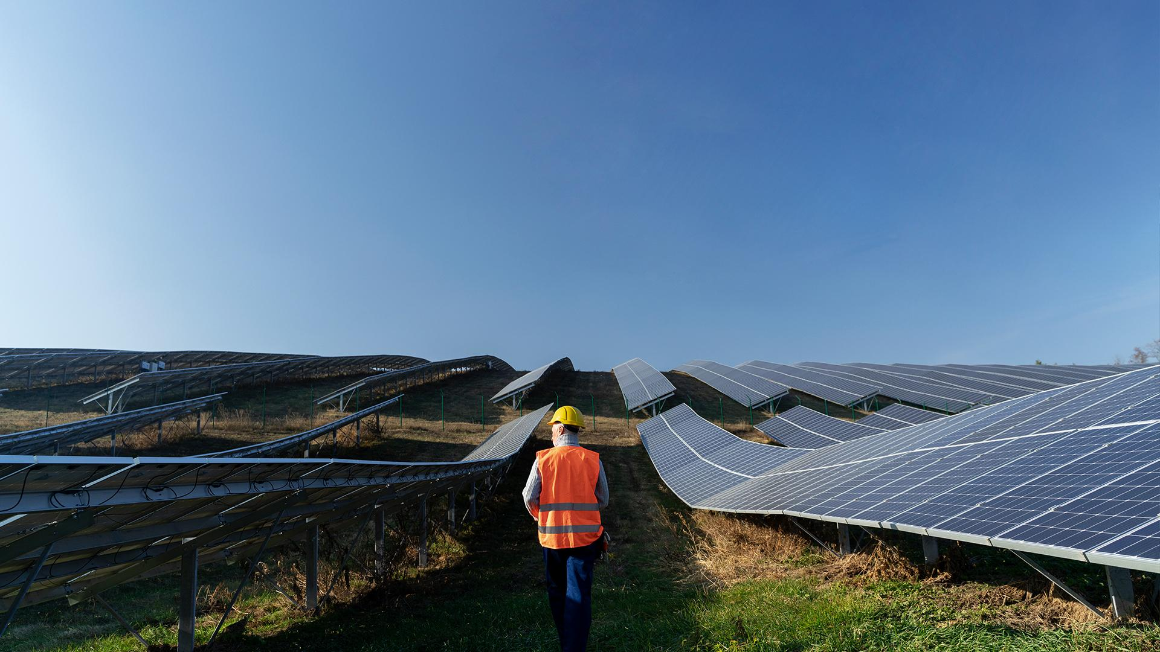
Thank you! Questions?

